Slide 1
Dietary Assessment and Interventions using AI, Wearables and LLM
T32 Spring 26 Seminar Series
Asiful Arefeen

Slide 2
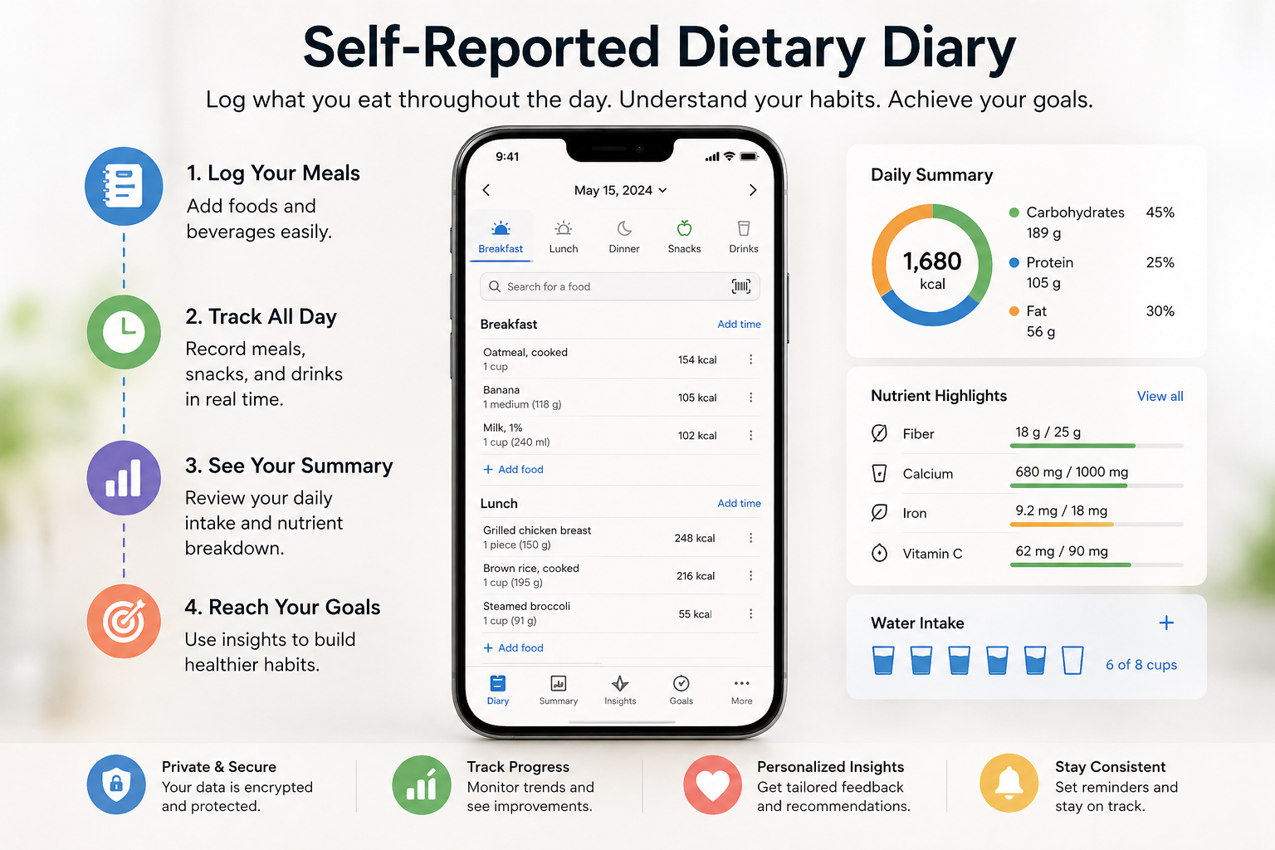
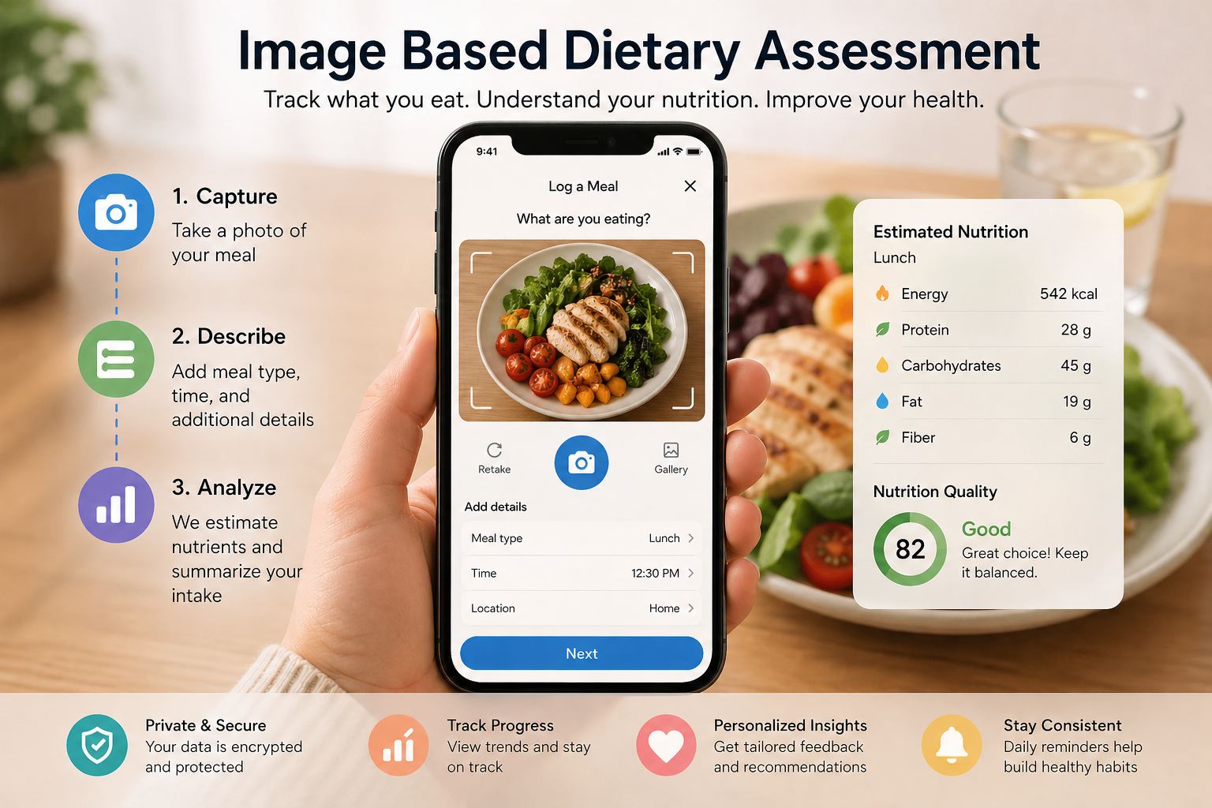
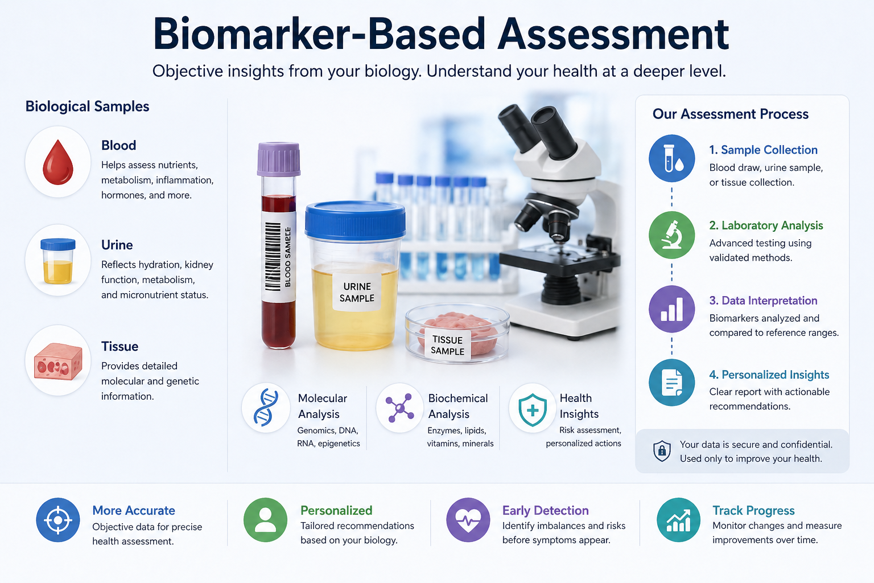
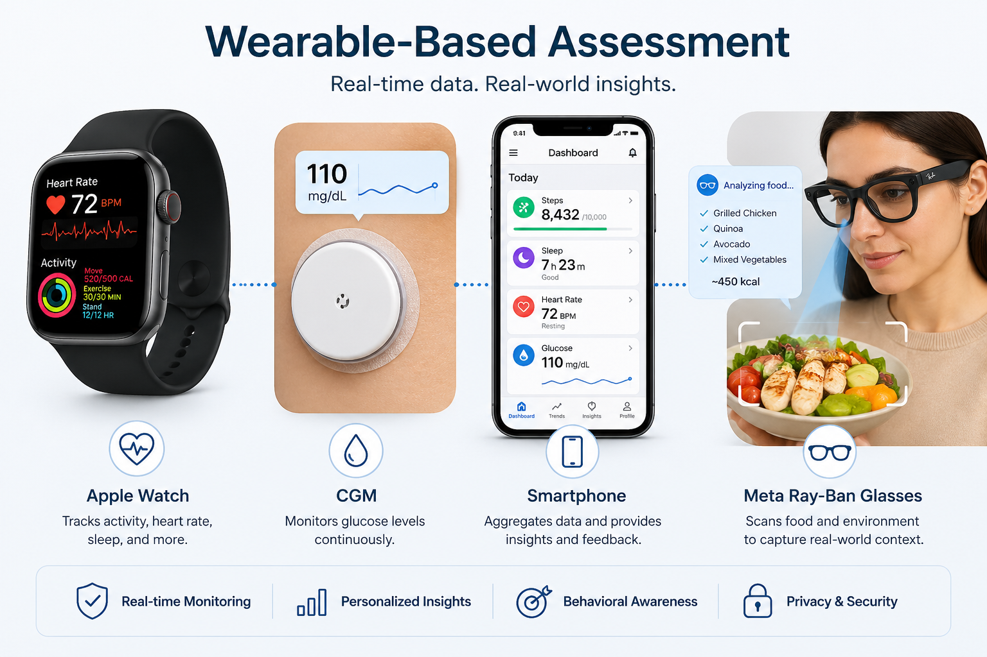
Dietary Assessment techniques
Wearable-based (CGM, Wristband, Sunglass)
++
Reduced reliance on memory
Passive & continuous tracking
Detailed behavioral insights
(Eating speed, frequency, patterns)
AI/ML can analyze intake with minimal user effort
--
Privacy issues, device costs, wearing discomfort, detection error, difficulty with portion sizes, battery/storage management, struggle with mixed dishes, sensitive data
Self-reporting
++
Low cost, easy to implement
Commonly used/accepted
Captures usual intake over time
--
Recall bias and memory errors
Underreporting / overreporting
High participant burden
Image-based
++
More accurate than self-reports, Visual record improves portion estimation, Easy and accessible (smartphones)
--
Requires user compliance (must take photos), Portion size estimation still difficult, Privacy issues
Biomarker-based (blood, urine, tissue)
++
Not dependent on self-report
Useful for specific nutrients (sodium, protein)
--
Expensive and invasive
Limited to certain nutrients (not full diet), Requires lab analysis and expertise

Slide 3

﻿Joint Embedding of Food Photographs and Blood Glucose for Improved Calorie Estimation
During data collection
Take food images, post-meal glucose pattern while subjects eat standardized meals
Use Vision Transformers (ViT) to create embeddings from the food images
Create Embeddings from the glucose patterns
Feed the embeddings to AI models to map them into consumed calories

Slide 4
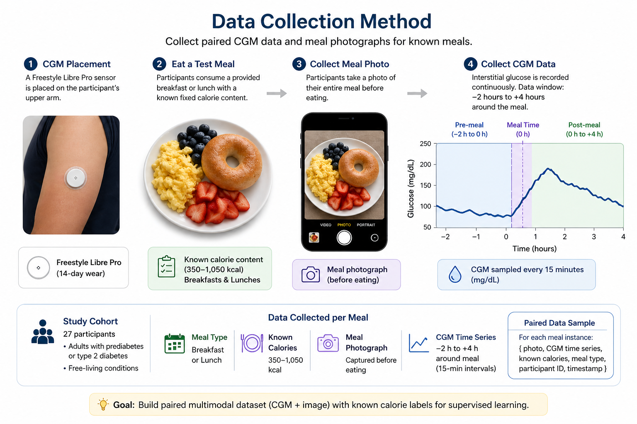
Data collection
Prediabetes – 12
Healthy – 10
T2D - 5

Slide 5
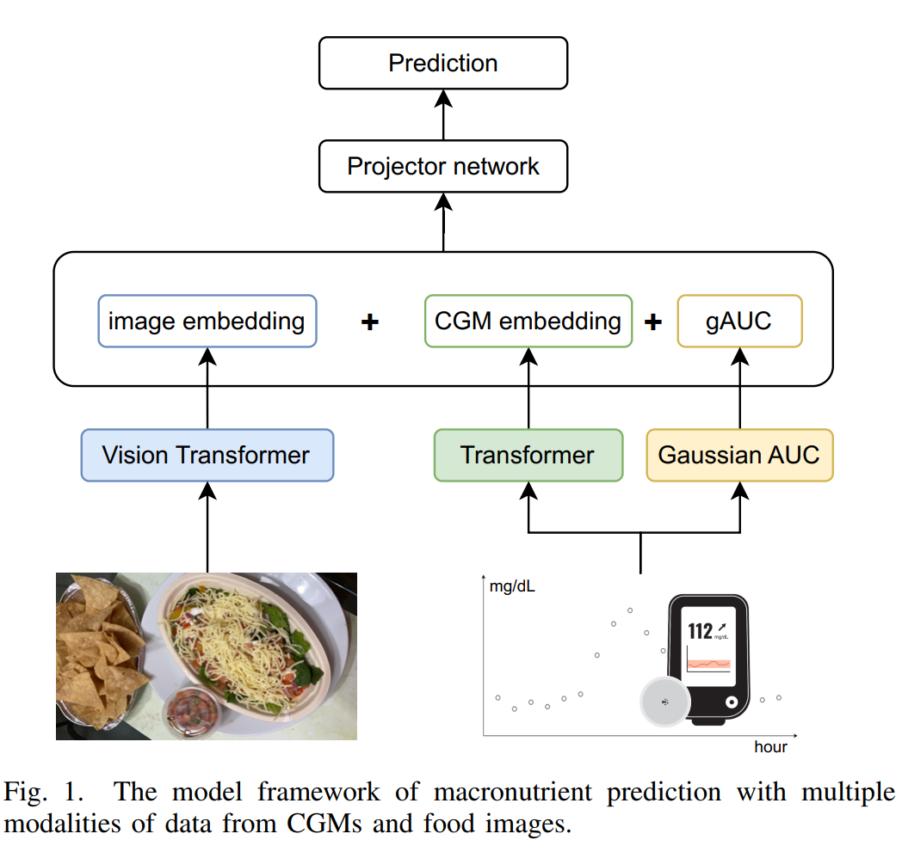
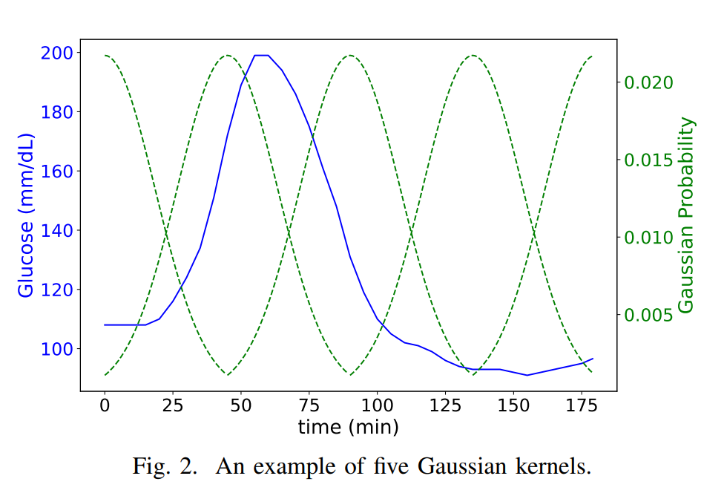
Embedding generation and model training

Slide 6
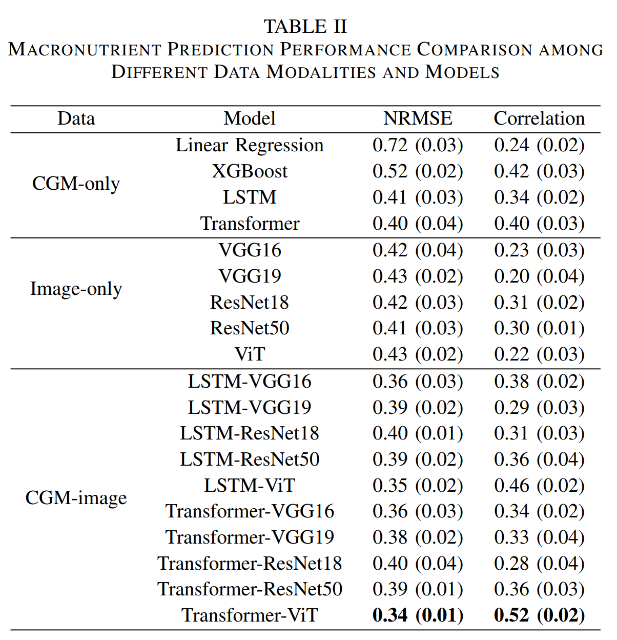
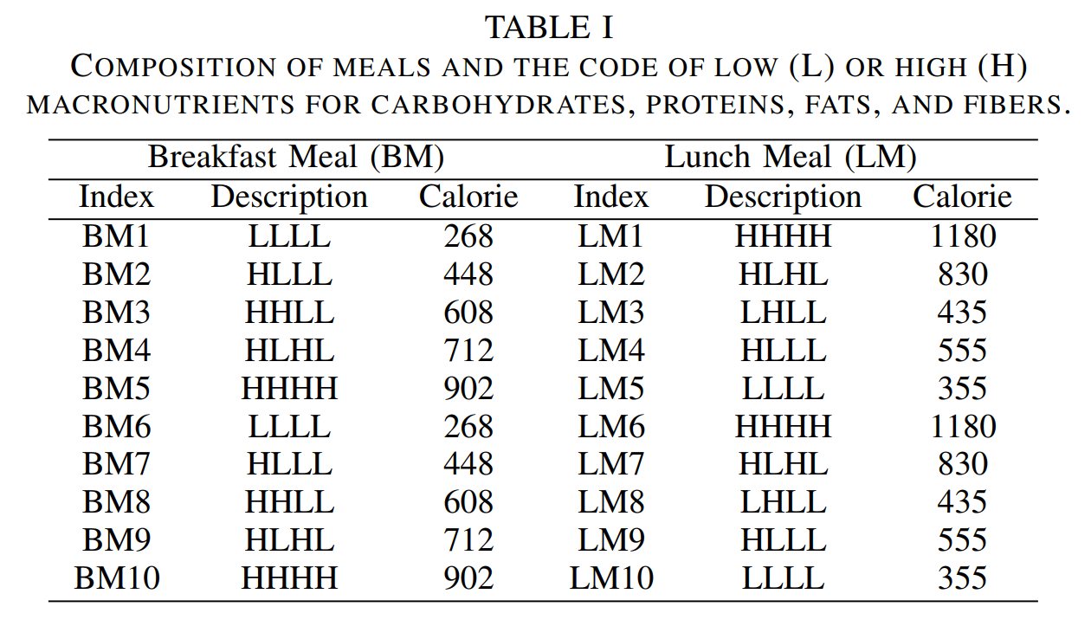
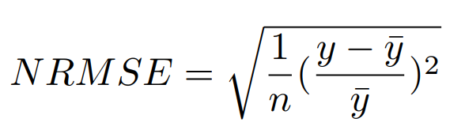
Results

Slide 7
MealMeter

Slide 8
Overview
Collect data in controlled setting using wearables: Glucose monitor, Wristband
Subjects eat standardized meals
Process the signals from the wearables, create features
Feed the features to the model and map them to macronutrients

Slide 9
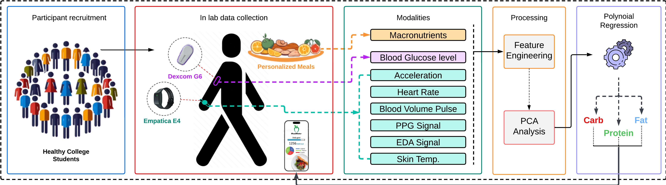
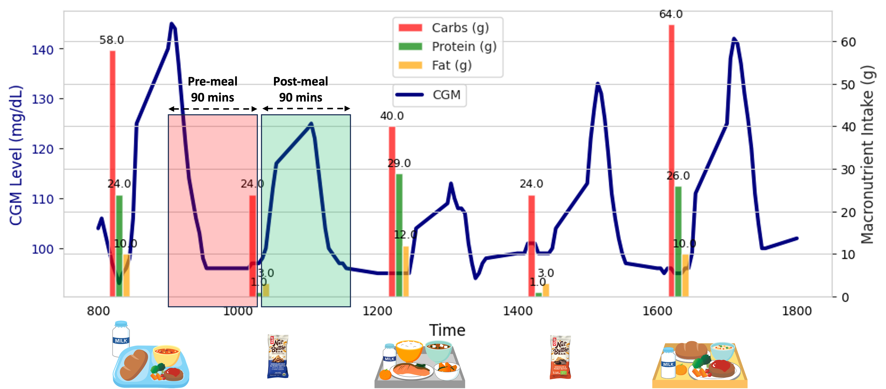
Data Collection

Slide 10
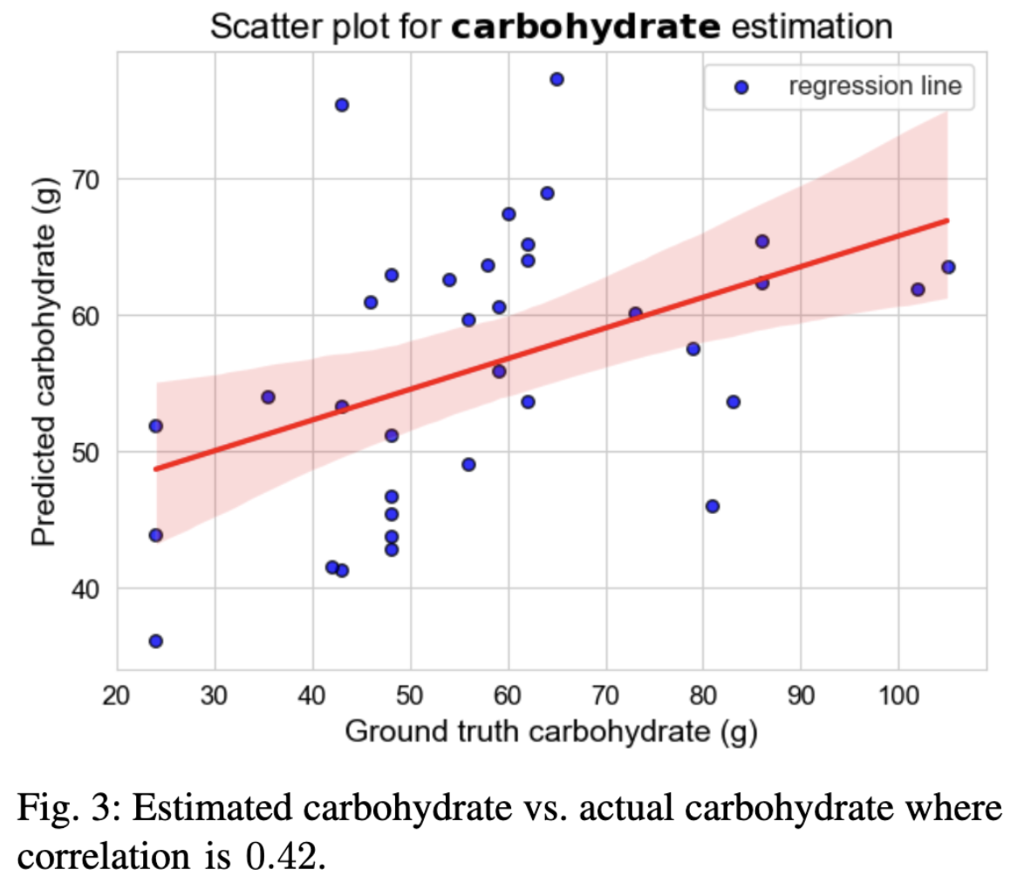
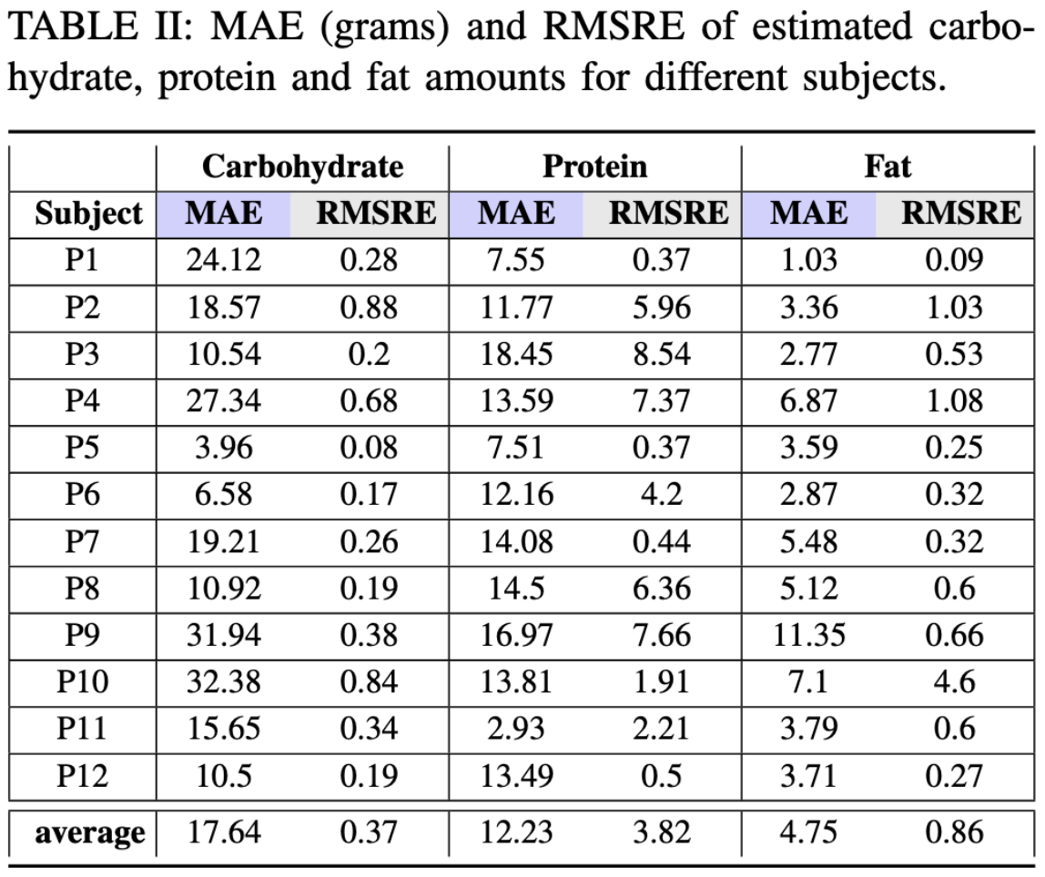
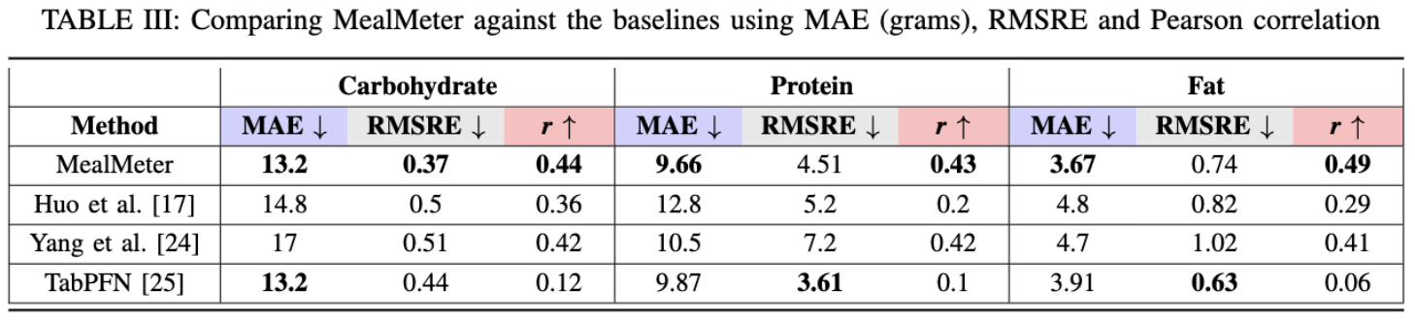
Results

Slide 11
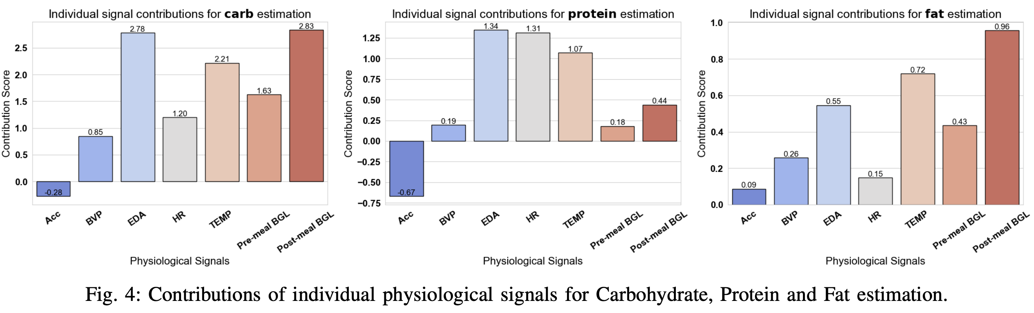
Helps/hurts prediction

Slide 12


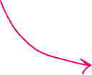

MetaPlate

Slide 13
Overview
Collect physiological and meal data from healthy college students in free-living condition
Use sensors: Glucose monitor, wristband for activity
Log meals using MyFitnessPal app
Train ML model to forecast maximum post-meal BGL
Use counterfactual AI to adjust meal macro-nutrients that ensures post meal BGL below 140 mg/dL
Use LLM-RAG technique to translate the counterfactual findings to actual meals and suggest them to user

Slide 14
Key terms
Counterfactual AI
Getting alternative hypothetical
scenario that satisfies certain constraints
LLM-Retrieval Augmented Generation
Providing resources to an LLM to get refined outputs
Without RAG: Answers from memory, results might be prone to error, inconsistent
With RAG: Results are more refined

Slide 15
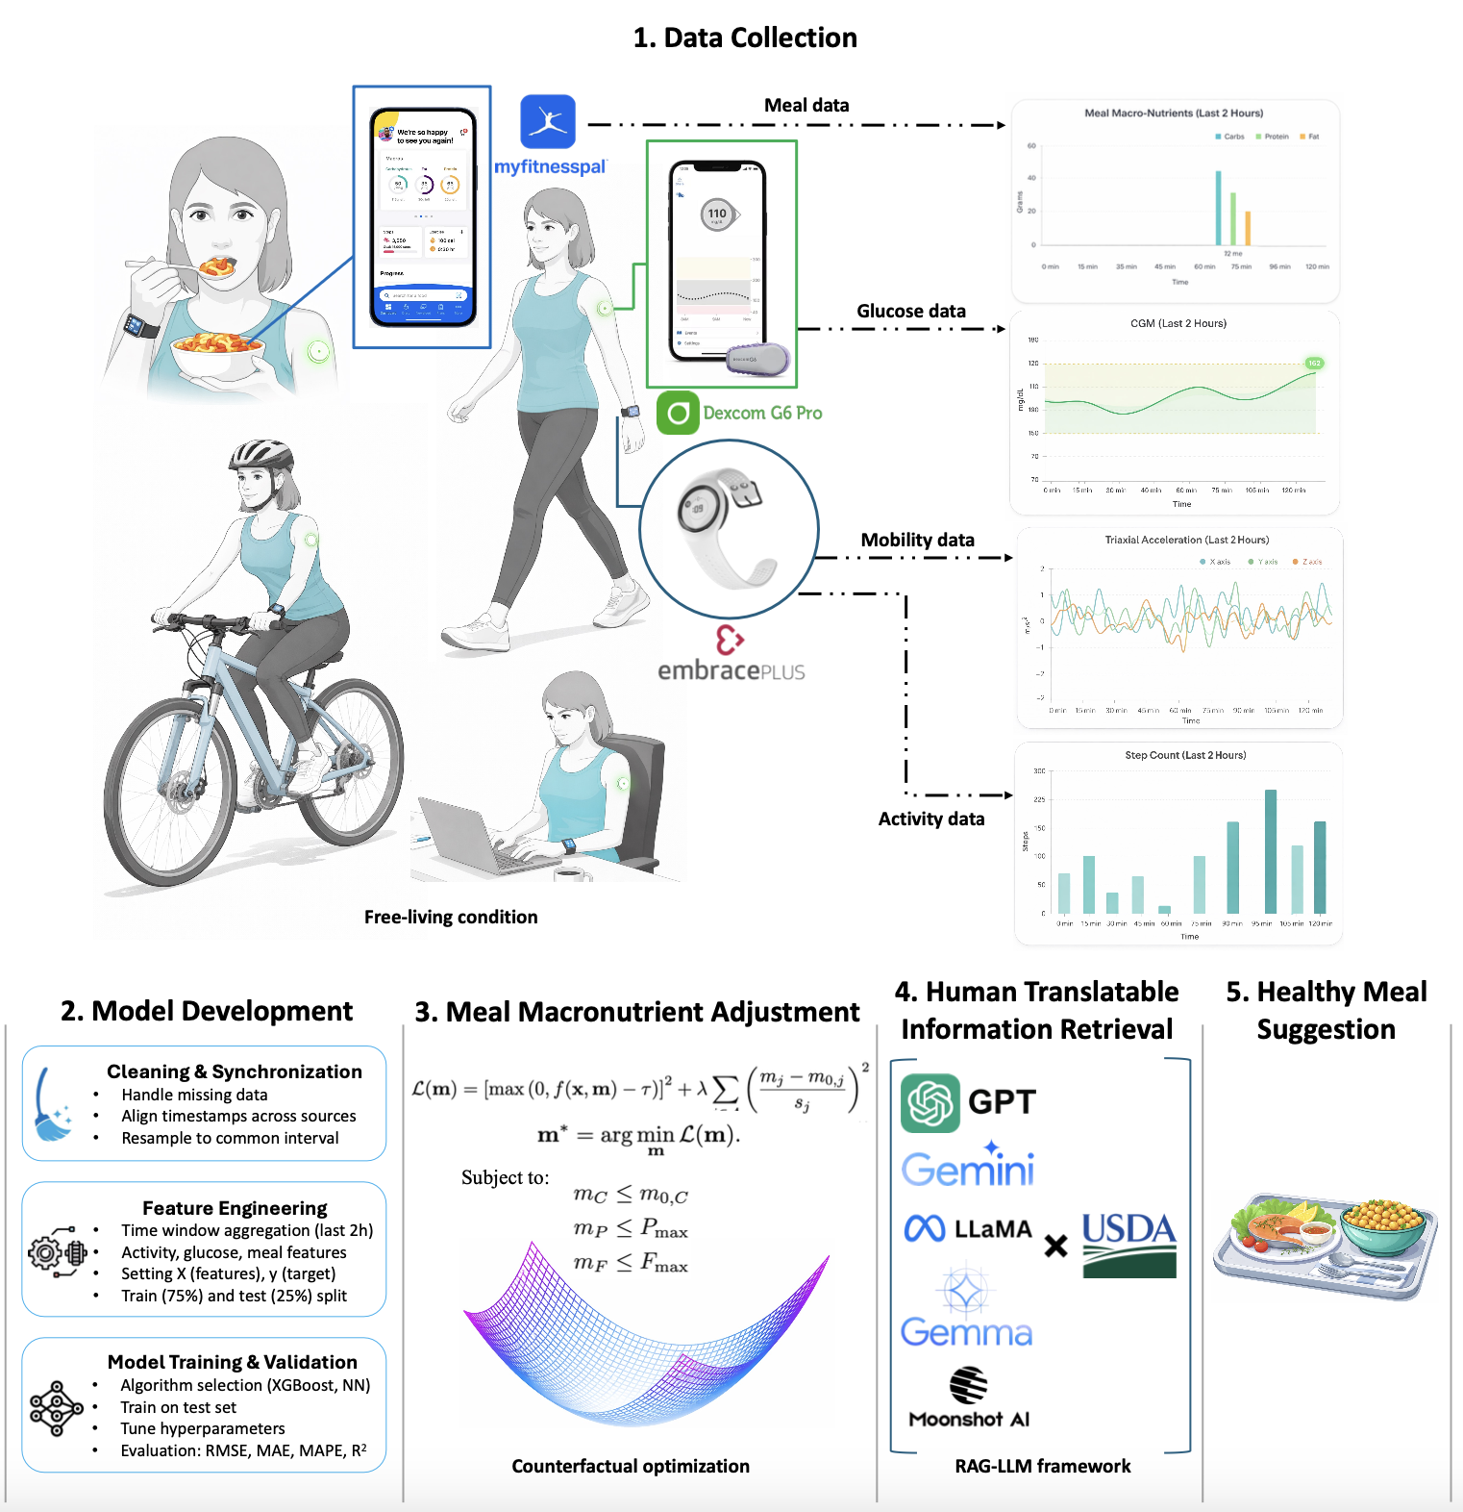


Slide 16
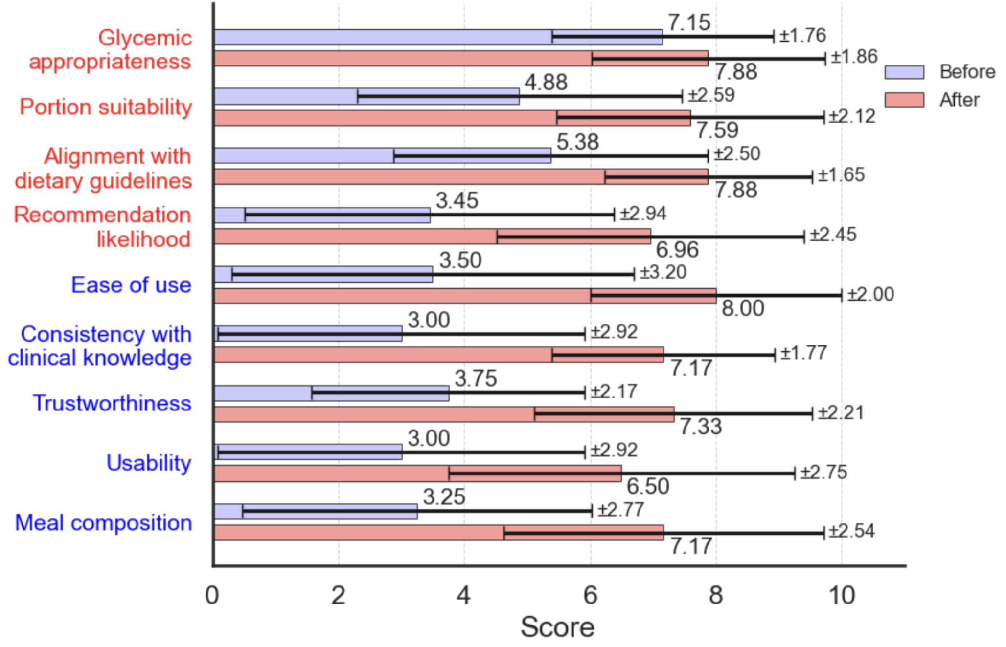
Refinement & Validation
Set an initial prompt
Generate results
Sample interventions from 10 random cases
Design a survey
Ask RDs to rate the interventions and the technology
…
Refine the RAG/prompt techniques, generate results, survey again

Slide 17
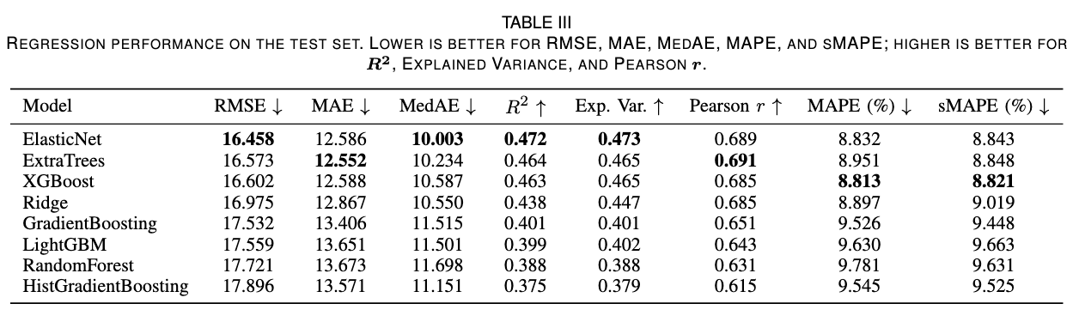
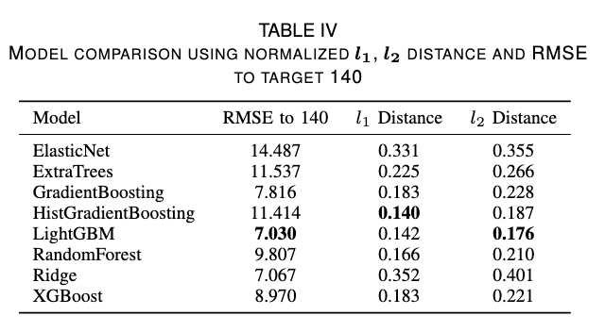
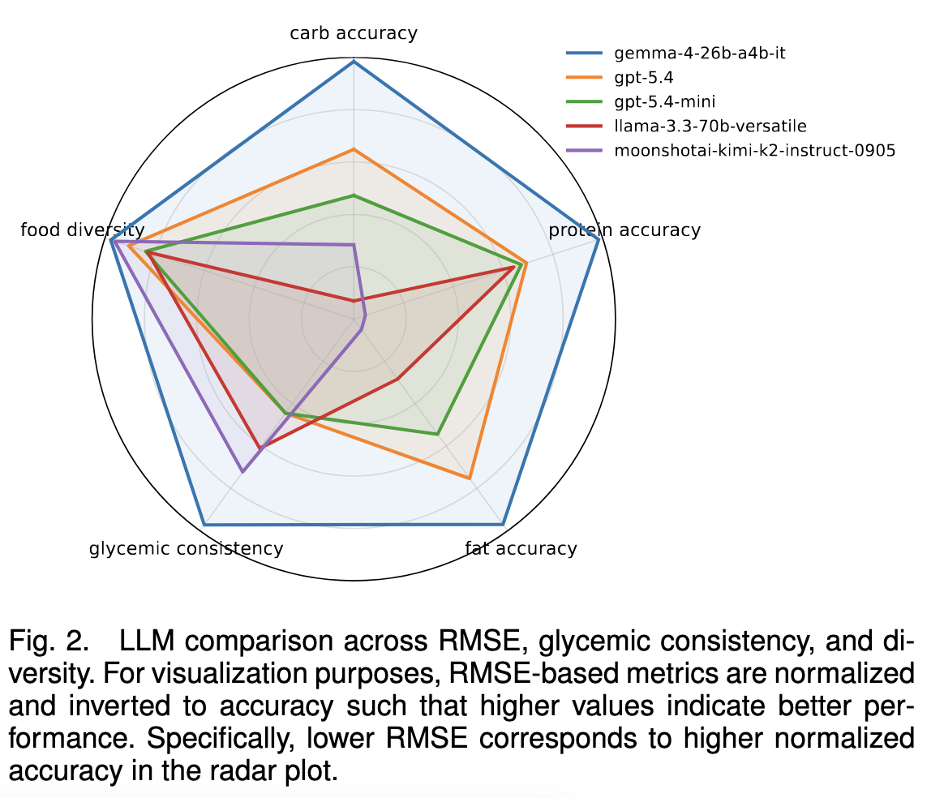
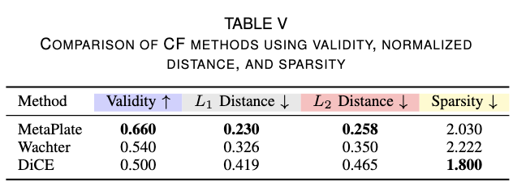
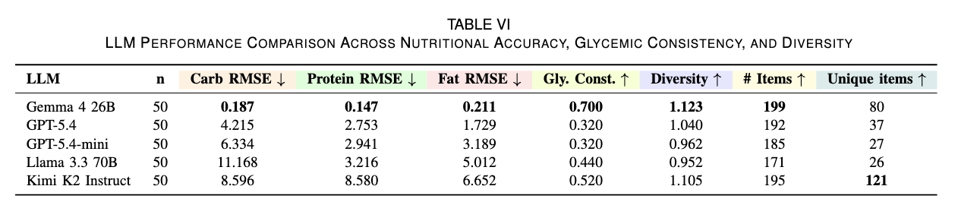


Validation

